Slide 1
ALGORITHMS FOR USECASES

Slide 2
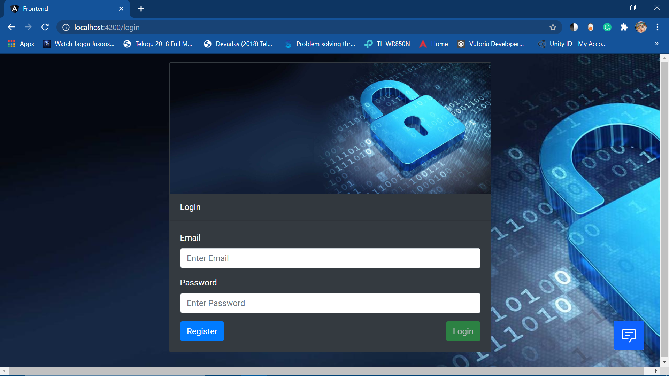
ALGORITHM FOR LOGIN COMPONENT
If the user already have an account, he should enter email and password for login.
If the new user enter our website, then the user should click on register button, to navigate to register page.
User will be able to login if and only if, the user details are present in database.
If details are present in database the user will be navigated to home page and he will get an alert “Welcome Back”
If the details are invalid, he will get an alert “Login Unsucessful”.

Slide 3
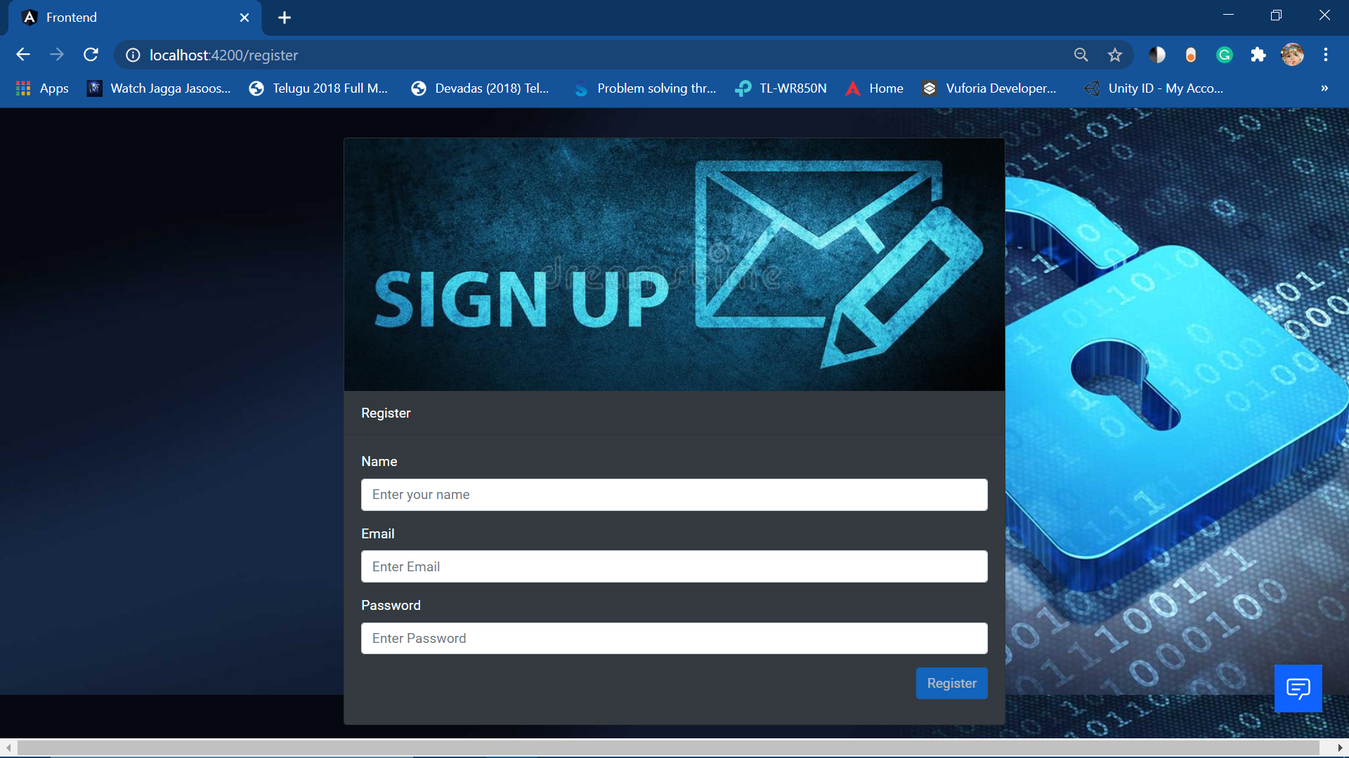
Algorithm for Register Component
User must fill all the three fields (Name,Email,Password) to enable our register button.
User must provide genuine email address to get a greeting mail from our website.
User must remember their login credentials in order to login again.

Slide 4
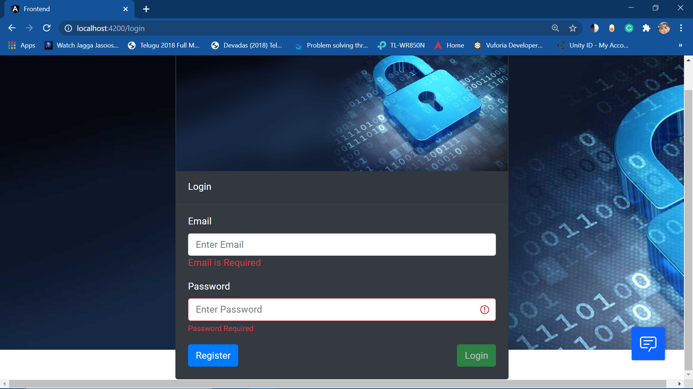
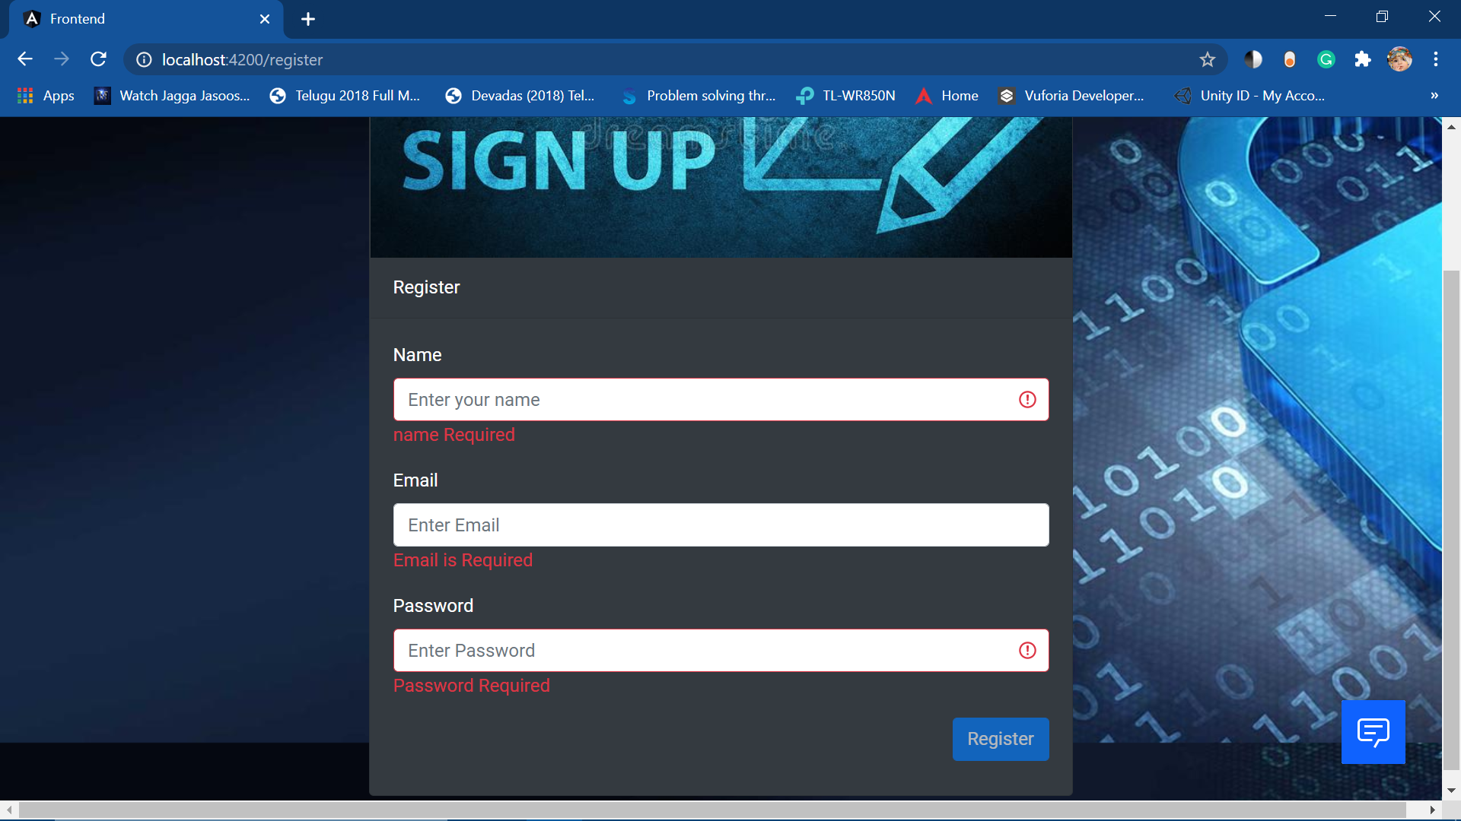
Algorithm for Validations
Both in Login and Register pages, the user must fill all the required forms to access our website.
We use angular forms for this.

Slide 5
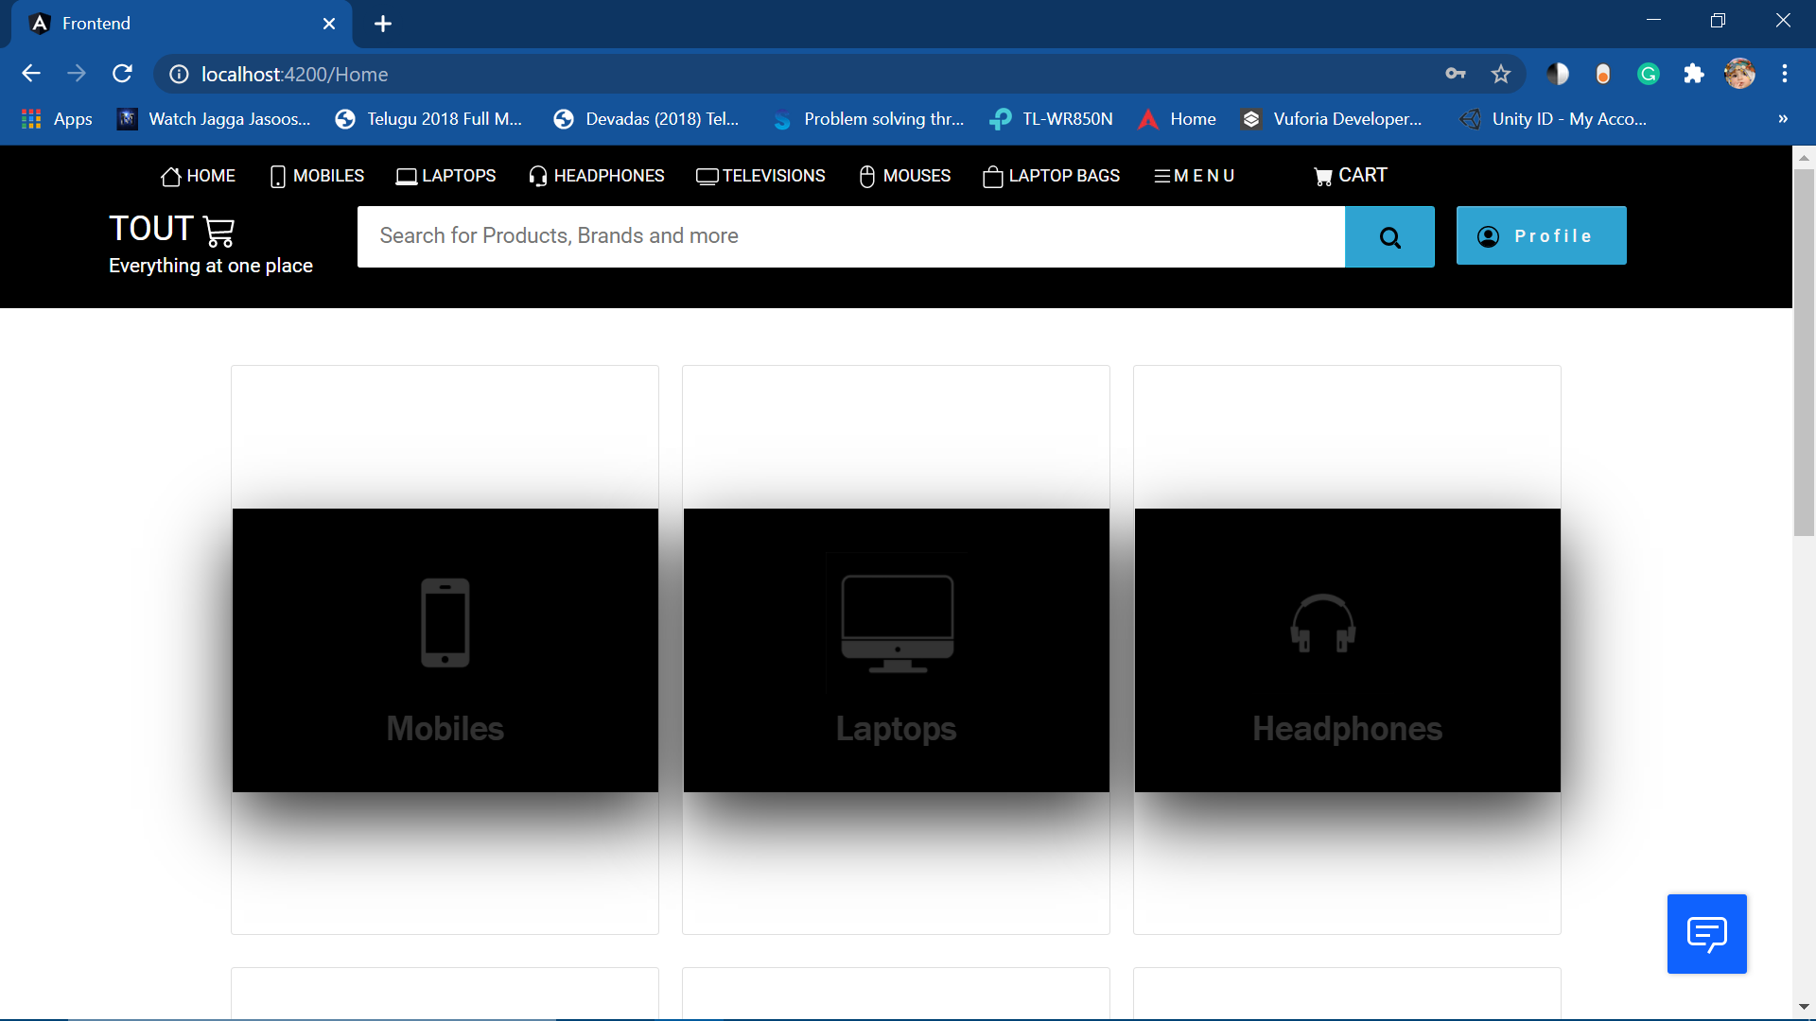
Algorithm for Navigation Bar
Nav Bar will have “search bar” , the user can search using it.
The links for all the product categories will be available on the top of nav bar.
By clicking on cart link, the user can see their items added to the cart.
By hovering the mouse on Profile button user will get two options:
1. My orders
2. Logout.

Slide 6
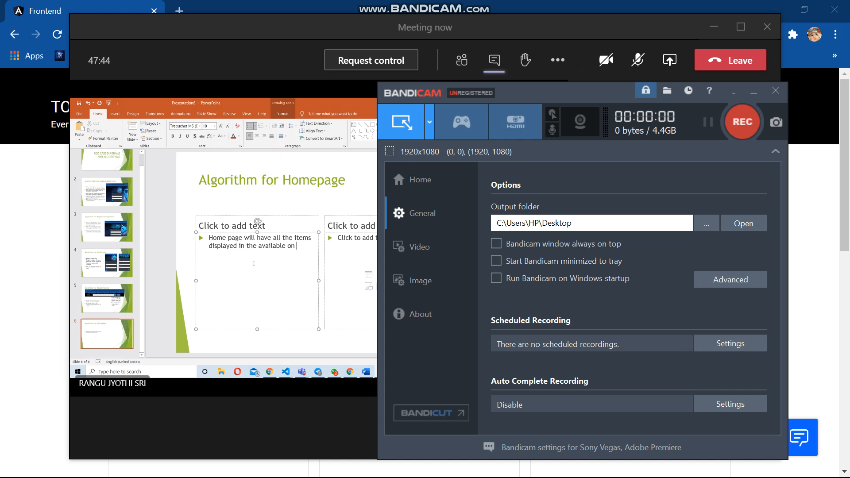
Algorithm for Homepage
Home page will have all the item categories displayed in the available on the database.
The navigation bar and footer will also be available on the home page.
By clicking on view more button in respective card , it will navigate to that respective category page.

Slide 7
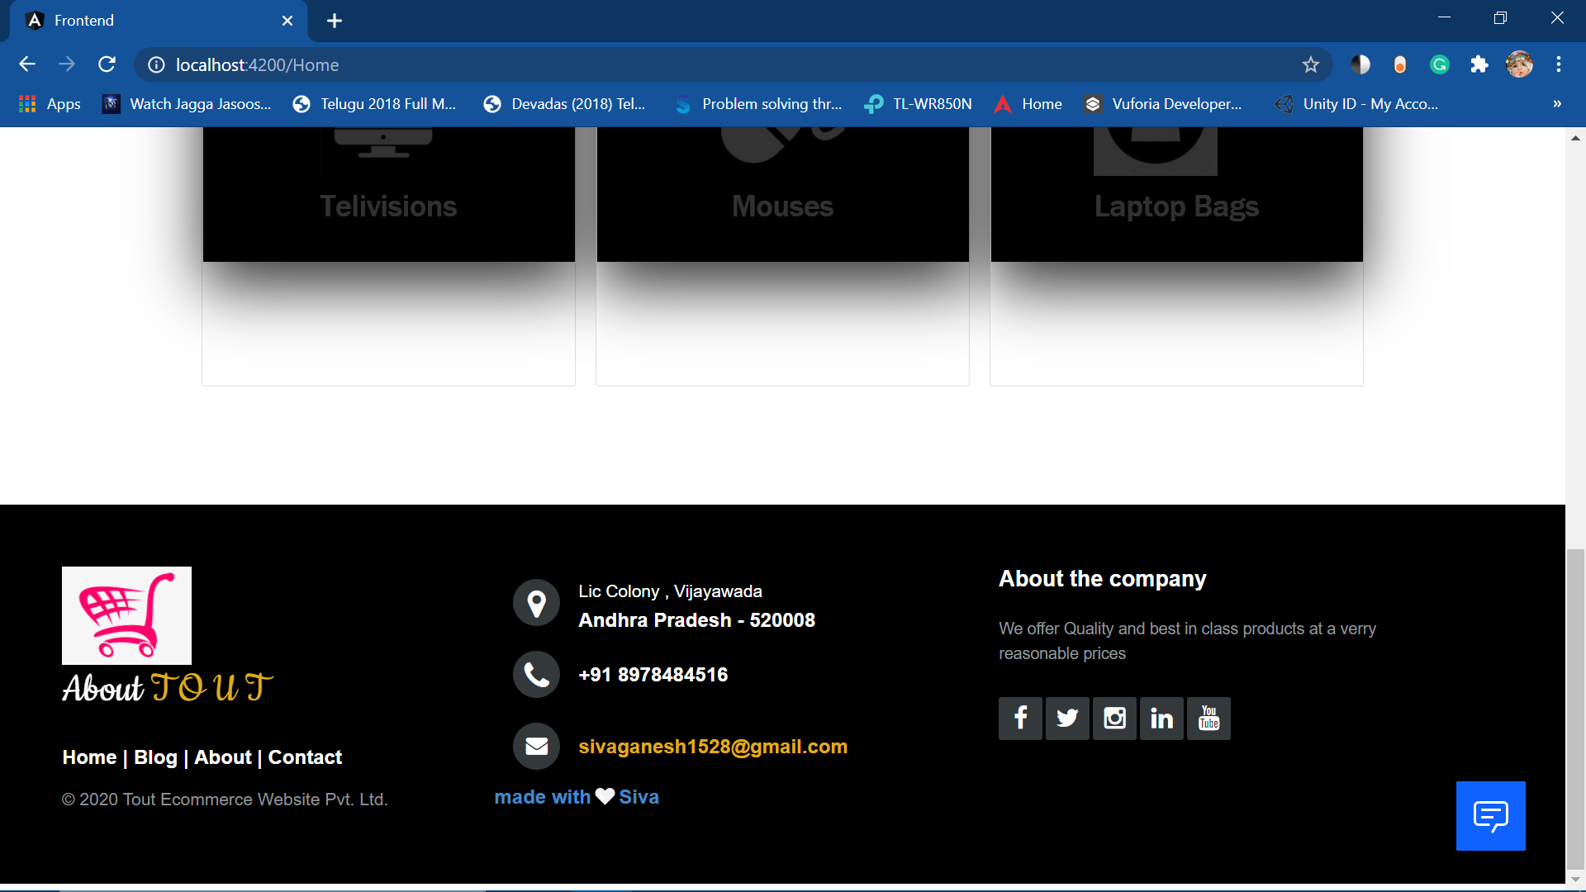
Algorithm for footer
The footer will have more information regarding our website.
The user can directly send an email or put a message regarding any issues or feedback very easily.

Slide 8
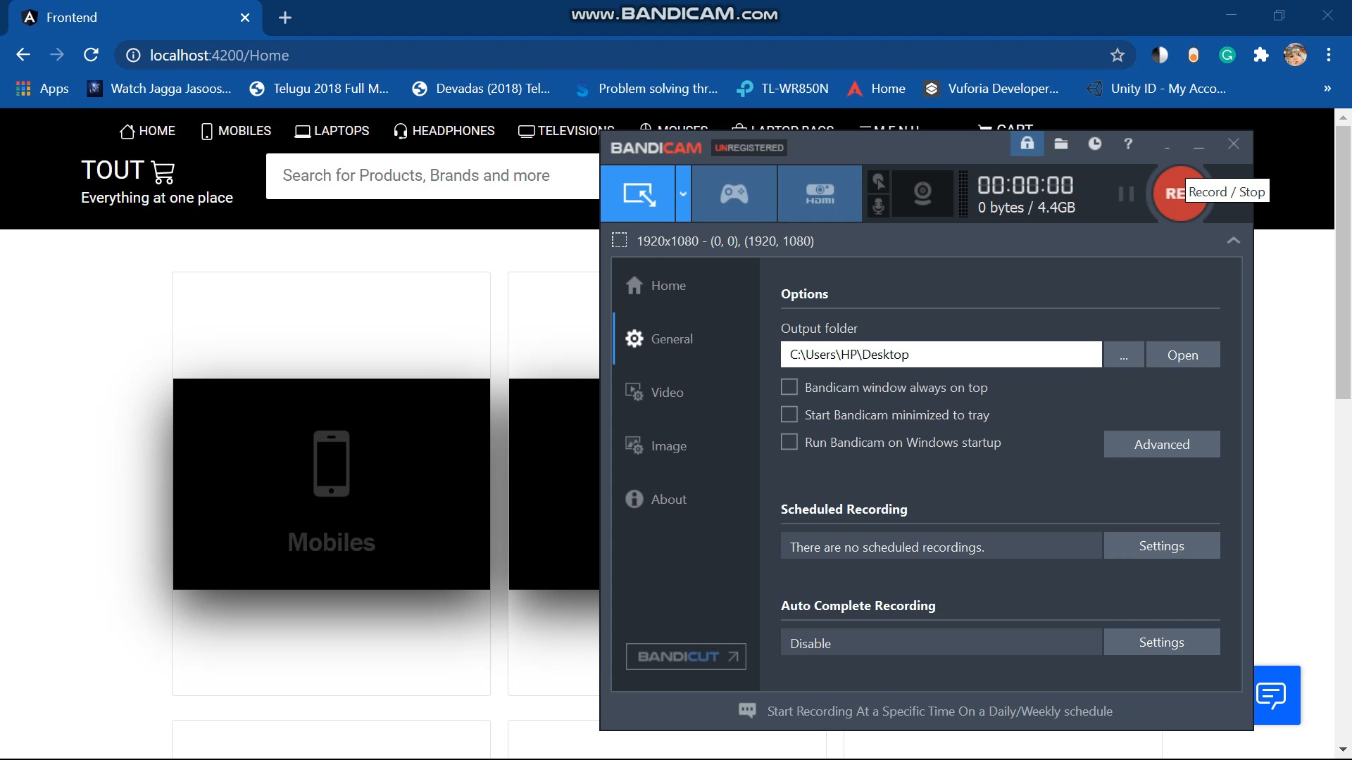
Algorithm for product components
Whenever the user clicks on product category button, it will navigate to that product category page and display all the available products of that category.
Whenever the user hover the mouse on any particular product that image card flip back on show more details and add to card button for each product.

Slide 9
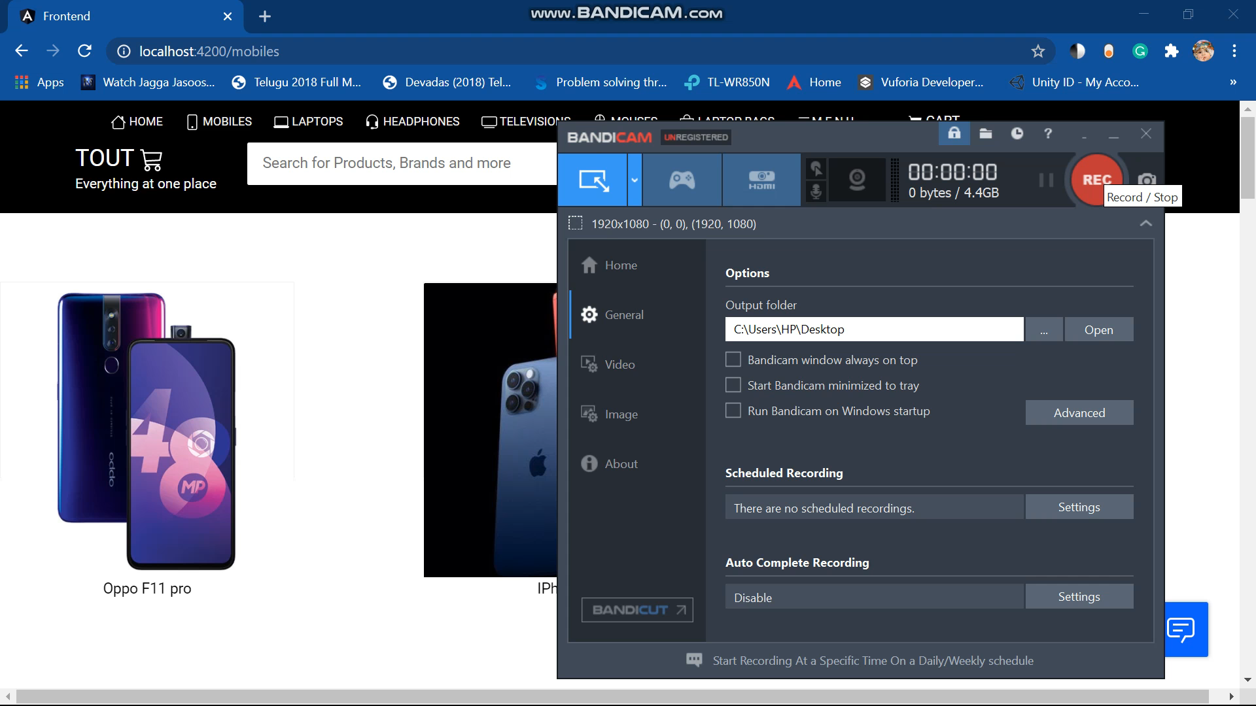
Algorithm for Cart Page
Whenever the user click on add to button the respected products will be his cart.
In cart page the user can view all the products which are added to his cart.
The user can increase or decrease the quantity of each item and he can also remove items from the cart.
The user can view the total bill of items simultaneously.

Slide 10
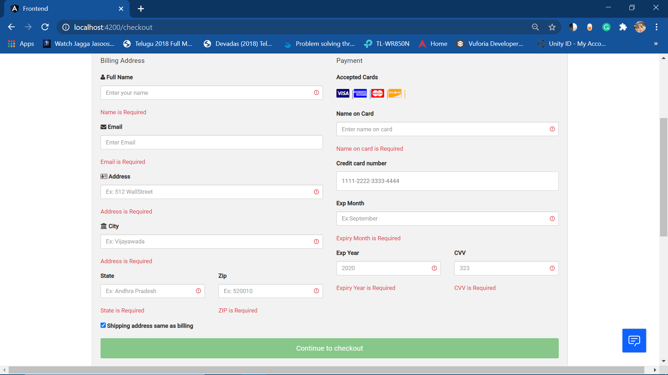
Algorithm for checkout page
In checkout page the user must fill all the required fields in order to make the payment.
If any field is left empty, the form validations will get activated and shows that particular field is required.
After filling all the required data only, the “Continue to checkout “ button will get activated.

Slide 11
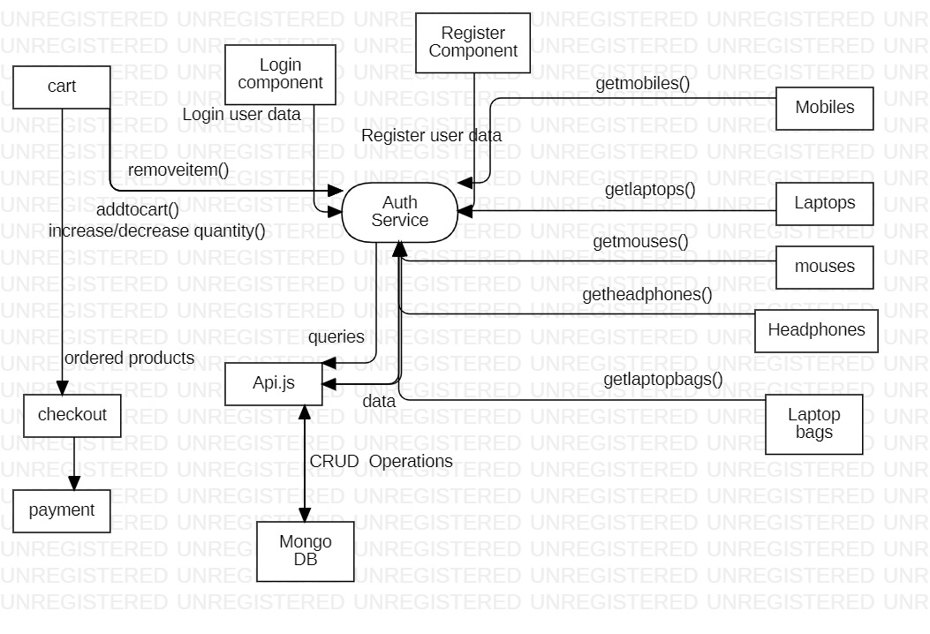
Dataflow of overall website

Slide 12
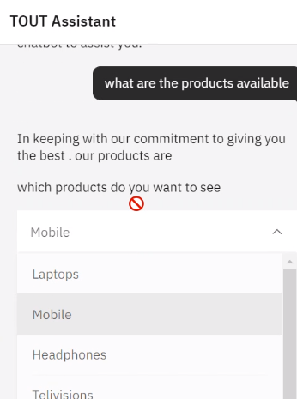
Algorithm for AI Chatbot
Step1:- sign in to IBM cloud and register with lite plan for Accessing the services.
Step2:- create an instance called Watson assistant c3 in the Services.
Step3:- launch the Watson assistant and a skill called Assistant or any name of your choice.
Step4:- Create an intent to help the assistant recognize the Intent of the user . we can add the examples to help The assistant train on recognizing the data.
Step5:- Create an entity or an object to store multiple Responses in on go .

Slide 13
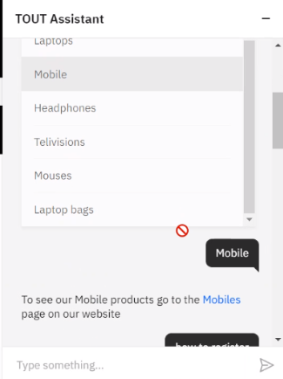
Algorithm for AI Chatbot
Step 6:- Scroll down to the dialog and the pre programme Nodes are welcome, anything else.
Step 7:- Next press on the menu icon and add a folder called Chat .
Step 8:- add a new node called greetings where the greeting Intent gets redirected and the response is being programmed and the It will give the reply.
Step 9:- Now add the new node called about_our_site . In Which the text response about the website.
Step 10:- Now add the new node with the intent menu and Child nodes containing the intents of menu like Laptops,mobiles,etc.

Slide 14
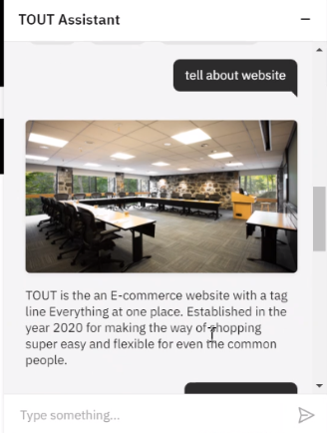
Algorithm for AI Chatbot
Step 11:- Add a new node called queries and and create child Node for the queries intents like payment info and Contact info, etc.
Step 12:- go back to the assistant page and go to webchat Navigate to embed copy the script code and add it In the html page.

